Slide 1
All Systems Go!
Python with Robots Mission 9
Lesson 2 Objectives 5-7

Slide 2

Pre-Mission Warm-Up
In your Mission 9 Lesson 2 log, answer the pre-mission warm-up question:
What do you know about room temperature?

Slide 3

Mission 9: All Systems Go!
In this mission you’ll get to know CodeBot’s internal system sensors.
Your ‘bot can measure its own battery voltage and CPU temperature.
And it can sense its orientation as well as impacts and vibration with the accelerometer.
Ah yes, CodeBot is self-aware!

Slide 4
Mission 9: All Systems Go!
For this lesson, we will work on the second goal:
Use the CPU temperature to detect changes in the local “weather”.
Robot, know thyself!

Slide 5
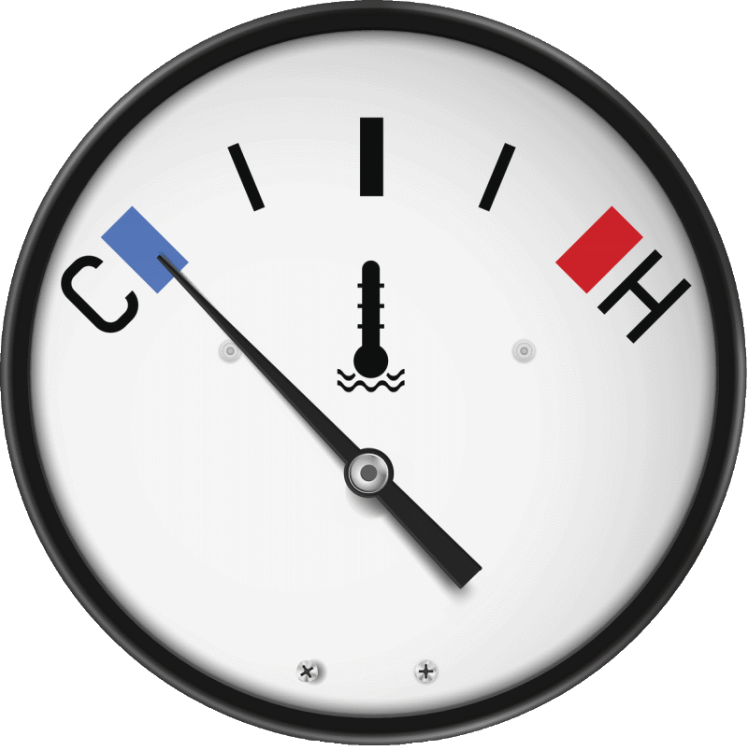
Objective #5: Sensing Temperature
Your bot’s CPU has an internal temperature sensor.
The system sensors have a function that lets you read the temperature in Celsius or Fahrenheit.
  system.temp_C()
  system.temp_F()

Slide 6
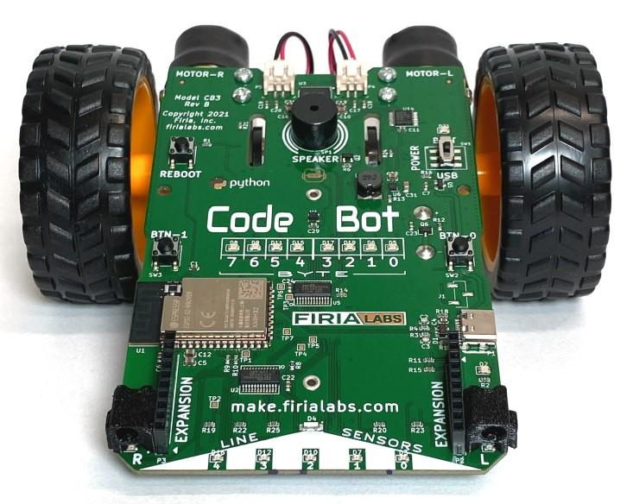
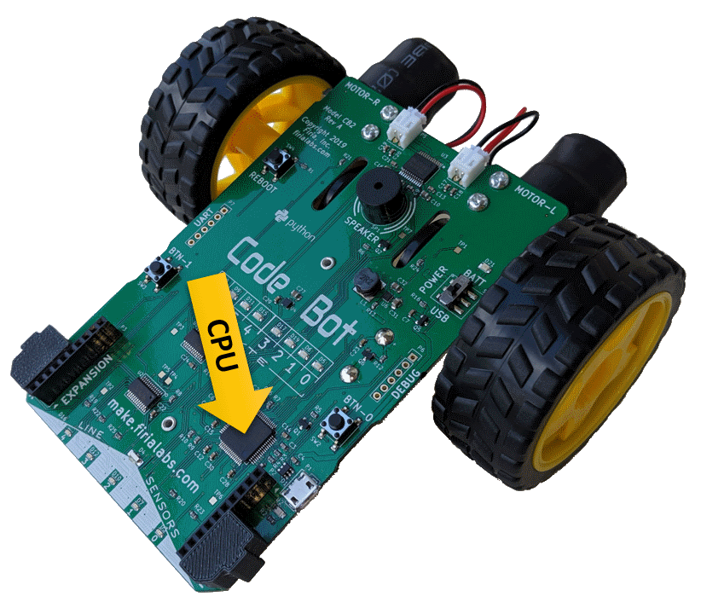
Objective #5: Sensing Temperature
The CPU’s reported temperature is influenced by:
The external temperature around the ‘bot.
The level of activity of the processor.
Note: The newer CodeBot CB3 will report temperatures about 10⁰ C warmer than the older CodeBot CB2.
CPU

Slide 7
Objective #5: Sensing Temperature
For the first activity, you will read and print the CPU temperature every 200 milliseconds.
You could use the sleep() function, but the time library has another function that is useful:
sleep_ms()
This function uses milliseconds instead of seconds.

Slide 8
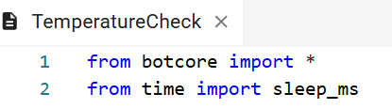
Objective #5 Activity
DO THIS:
Start a new file called TemperatureCheck.
Import the botcore library.
Import sleep_ms (not sleep) from the time library.

Slide 9
Objective #5 Activity
DO THIS:
Complete the code
Use a while True loop to:
  Read the temperature in celsius
  Print the reading to the console
  Sleep for 200 milliseconds
Try doing the code on your own.

Slide 10
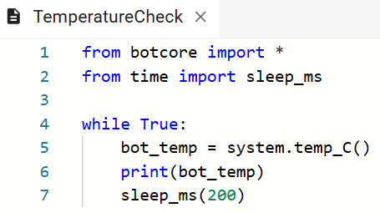
Objective #5 Activity Code

Slide 11
Objective #5 Activity
DO THIS:
Open the console panel.
Run the program.
Observe the ambient (surrounding) temperature.
Stop the code after a few seconds.
Record the last five readings in the mission log.
Find the average.

Slide 12
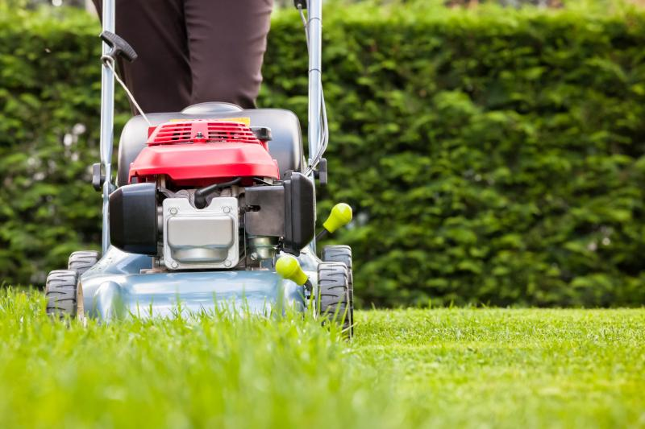
Objective #6: Smoothing the Data
You might notice that the “raw” temperature readings jump around a bit.
It could be variations in temperature.
But it could also be accuracy limitations of the sensor.
The data is noisy!
Your next step will be to smooth out the data with a moving average algorithm.

Slide 13
Objective #6: Moving Averaging Algorithm
This algorithm will use a list.
You learned about lists in Mission 6.
You define an empty list using square brackets:
samples = []
You add items to the list using append:
samples.append(new_item)
You count the number of items in the list using len():
num_items = len(samples)

Slide 14
Objective #6: Moving Averaging Algorithm
Algorithm steps:
Define an empty list for the samples.
samples = []
Define a function that will average the list.
def avg_list(nlist)

Slide 15
Objective #6: Moving Averaging Algorithm
In the function:
Initialize variables for count, sum and i.
  count is the number of items in the list.
  sum will start at 0 and then all items will be added to it.
  i is used as the loop counter, and also the index of the item.
  count = len(nlist)
  sum = 0
  i = 0

Slide 16
Objective #6: Moving Averaging Algorithm
In the function:
Use a while loop to traverse a list and sum the items.
while i < count:
sum = sum + nlist[i]
i = i + 1
When the loop ends, return the average.
  This can be done with one step!
  return sum / count

Slide 17
Objective #6: Moving Averaging Algorithm
In the main program:
Call the function when 5 items are appended.
Print the average.
Clear the list.
if len(samples) == 5:
avg = avg_list(samples)
print(“Avg Temp:”, avg)
samples.clear()

Slide 18
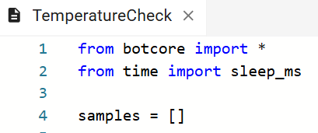
Objective #6 Activity
DO THIS:
Modify your code.
Define an empty list

Slide 19
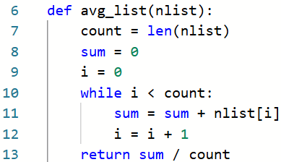
Objective #6 Activity
DO THIS:
Define a function that averages the list temperatures.

Slide 20
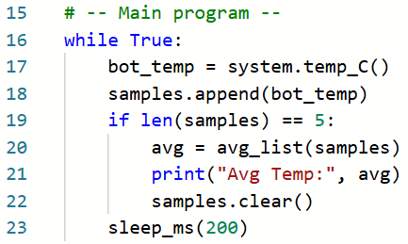
Objective #6 Activity
DO THIS:
Append each bot_temp reading to the list.
Call the function when the list has 5 temperatures.
Print the average and clear the list.

Slide 21
Objective #6 Activity
DO THIS:
During objective 5, you had to find the average of five temperatures.
For this objective, the computer will do the math for you!
Run the code and observe the results.
You will still see variations, but they should be smaller now.
Stop the code and record the last three averages.

Slide 22
Objective #6 Activity
DO THIS:
Try different sample sizes for the list.
Change the number you compare to len(samples).
Then run the code again and observe the results.
Stop the code and record the last three averages.
Repeat this experiment for two more sample sizes.
Which sample size worked the best for you? Change the comparison to the number of samples that worked best.

Slide 23
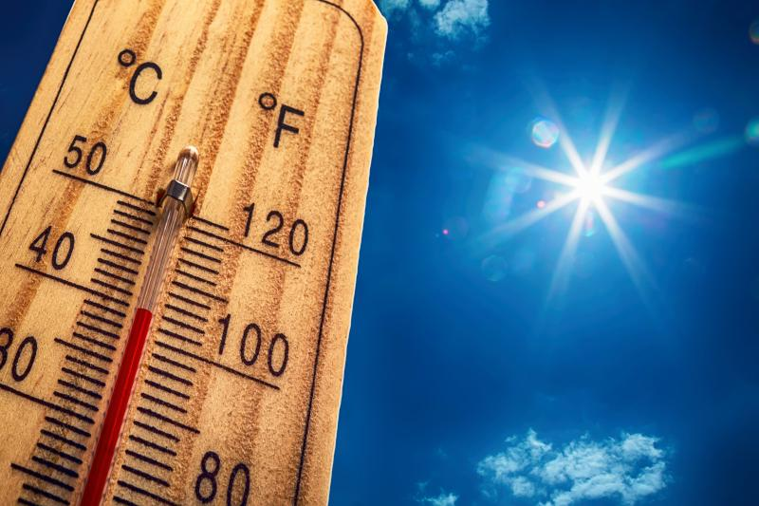
Objective #7: Temperature-Controlled Lights!
Time to make a temperature-controlled system.
First make note of the average ambient temperature you ‘bot is reading.
The ambient temperature is the temperature of the room, or surroundings.
This will be the baseline temperature.
This is the beginning, or expected, temperature.

Slide 24
Objective #7: Temperature-Controlled Lights!
A temperature-controlled system needs to stay within a specific range.
This is called a deadband.
For our system, the deadband will be 3⁰C around the baseline.
If the baseline is 37⁰C, we expect the system to stay within 34⁰C to 40⁰C.
A lower or higher temperature can trigger a response.

Slide 25
Objective #7: Temperature-Controlled Lights!
Create a UI (user interface) for the temperature-controlled system.
Keep the LEDs off when the temperature is controlled.
If the temperature is too hot, turn on the red user LEDs.
If the temperature is too cold, turn on the greed line sensor LEDs.

Slide 26
Objective #7: UI Algorithm
Define a new function that uses the average temperature for a parameter.
Compare the average to the baseline + deadband.
If the average is higher, turn on user LEDs.
Compare the average to the baseline - deadband.
If the average is lower, turn on the line sensor LEDs.
Call the function in the main program, whenever the average is returned.

Slide 27
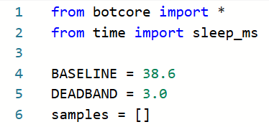
Objective #7 Activity
DO THIS:
Define two constants (use ALL CAPS) for baseline and deadband.
Use an average temperature reading from Objective 6 as the value for baseline.

Slide 28
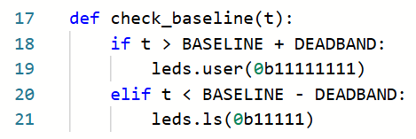
Objective #7 Activity
DO THIS:
Define a new function to check the baseline.

Slide 29
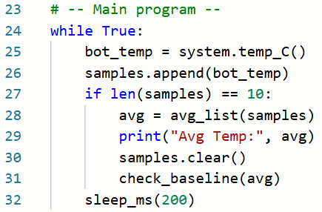
Objective #7 Activity
DO THIS:
Call the function in the main program’s if statement.

Slide 30
Objective #7 Activity
DO THIS:
Open the console panel to observe the average temperature.
Run the code.
The average temperature should be within the acceptable range, and no LEDs are turned on.

Slide 31
Objective #7 Extension – mild
You probably want to test the control system to see if the UI works properly with averages that aren’t within the range.
Changing the CodeBot CB3 temperature isn’t easy because it has a metal shield covering the sensor and electronic parts.
We can test the control system with code.
Metal Shield

Slide 32
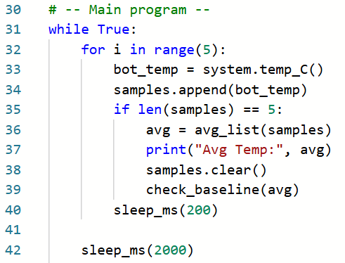
Objective #7 Extension – mild Activity
DO THIS:
Add this code to your main program.
It is a quick way to do a loop five times.
Add a long sleep after the loop.
Indent block

Slide 33
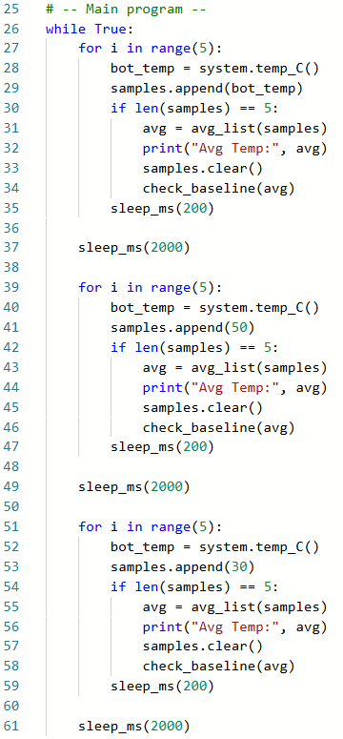
Objective #7 Extension – mild Activity
DO THIS:
Copy and paste the loop two more times.

Slide 34
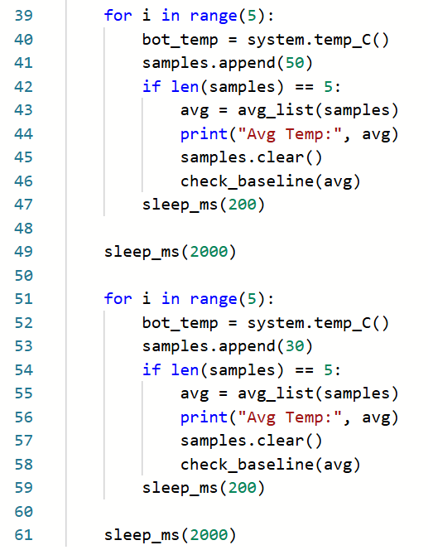
Objective #7 Extension – mild Activity
DO THIS:
Change the values that are appended by picking specific numbers above and below the deadband range.

Slide 35
Objective #7 Extension – mild Activity
DO THIS:
Open the console panel to observe the average temperature.
Run the code.
The averages should cycle between acceptable, to too high, to too low.
Does the program work as you intended? Record what you observe.

Slide 36
Objective #7 Extension – mild
Hopefully you noticed that the LEDs don’t turn off after they are on.
This is not the intention!
They should only be on when the average temperature is too high or too low.
The check_baseline() function needs to be fixed.

Slide 37
Objective #7 Extension – mild Activity
DO THIS:
Add code to the check_baseline() function to turn off LEDs when they shouldn’t be on.
Add an else: to the if statement that turns off all LEDs when the average is acceptable.
Can you do this on your own?

Slide 38
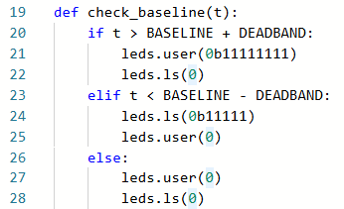
Objective #7 Extension – mild Activity

Slide 39
Objective #7 Extension – mild Activity
DO THIS:
Open the console panel to observe the average temperature.
Run the code.
The averages should cycle between acceptable, to too high, to too low.
Does the program work as you intended?
Record in your mission log what you did to make the function work properly.

Slide 40
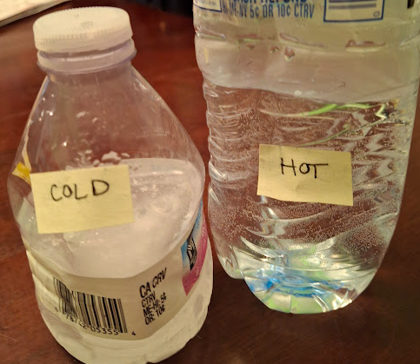
Objective #7 Extension – CodeBot CB2
If you have a CodeBot CB2, you can more easily affect the ambient temperature.
DO THIS:
Fill one empty disposable water bottle with a
little water and heat in a microwave.
Fill another empty bottle with cold water, or use an ice pack.

Slide 41
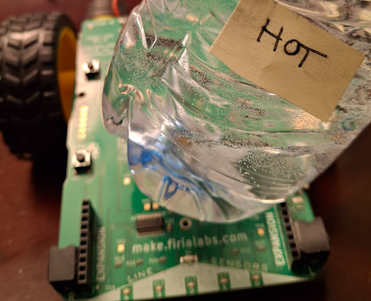
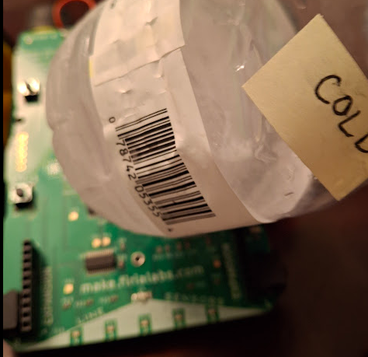
Objective #7 Extension – CodeBot CB2
DO THIS:
Run the program.
Place a water bottle or ice pack close to the CPU and observe the average temperature in the console panel.
The average temperature should get hotter or colder. Adjust the DEADBAND smaller if needed.
Does the program work as expected?

Slide 42

Extension – medium
Extend the UI by adding a beep.
If the average temperature is too high, sound a short high pitch.
If the average temperature is too low, sound a short low pitch.

Slide 43
Extension – spicy
The program uses only the sensor reading in Celsius.
Define another function that reads the sensor in Fahrenheit.
Use a button press to determine if the ‘bot uses Celsius or Fahrenheit.

Slide 44
Post-Mission
Hey! You’ve made a thermostat!
Think about it –
If the average temperature is too low, turn on the heating element.
If the average temperature is too high, turn on the cooling fan.
Keep a deadband around the target temperature so you don’t constantly cycle heater/fan, wearing out the equipment.

Slide 45
Post-Mission Reflection
Complete the post-mission reflection in your Mission 9 Lesson 2 Log:
How could you use the temperature-control system with other CodeBot programs?

